Slide 1

Pattern Classification
All materials in these slides were taken from
Pattern Classification (2nd ed) by R. O. Duda, P. E. Hart and D. G. Stork, John Wiley & Sons, 2000 with the permission of the authors and the publisher

Slide 2
Chapter 1: Introduction to Pattern Recognition (Sections 1.1-1.6)
Machine Perception
An Example
Pattern Recognition Systems
The Design Cycle
Learning and Adaptation
Conclusion

Slide 3
Machine Perception
Build a machine that can recognize patterns:
  Speech recognition
  Fingerprint identification
  OCR (Optical Character Recognition)
  DNA sequence identification

Slide 4
An Example
“Sorting incoming Fish on a conveyor according to species using optical sensing”
Sea bass
Species
Salmon

Slide 5
Problem Analysis
  Set up a camera and take some sample images to extract features
    Length
    Lightness
    Width
    Number and shape of fins
    Position of the mouth, etc…
    This is the set of all suggested features to explore for use in our classifier!

Slide 6
Preprocessing
  Use a segmentation operation to isolate fishes from one another and from the background
Information from a single fish is sent to a feature extractor whose purpose is to reduce the data by measuring certain features
The features are passed to a classifier

Slide 7
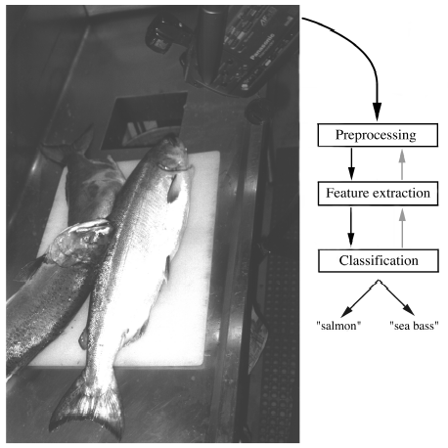

Slide 8
Classification
  Select the length of the fish as a possible feature for discrimination

Slide 9
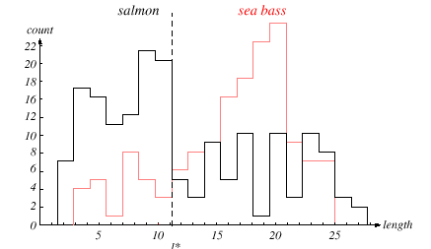

Slide 10
The length is a poor feature alone!
Select the lightness as a possible feature.

Slide 11
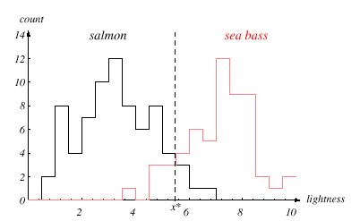

Slide 12
Threshold decision boundary and cost relationship
  Move our decision boundary toward smaller values of lightness in order to minimize the cost (reduce the number of sea bass that are classified salmon!)
  Task of decision theory

Slide 13
Adopt the lightness and add the width of the fish
Fish x^{T} = [x₁, x₂]
Lightness
Width

Slide 14
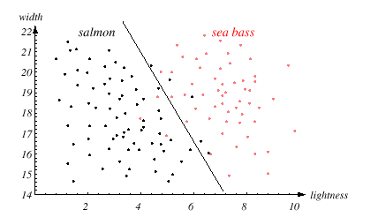

Slide 15
We might add other features that are not correlated with the ones we already have. A precaution should be taken not to reduce the performance by adding such “noisy features”
Ideally, the best decision boundary should be the one which provides an optimal performance such as in the following figure:

Slide 16
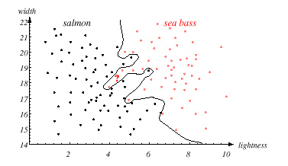

Slide 17
However, our satisfaction is premature because the central aim of designing a classifier is to correctly classify novel input
Issue of generalization!

Slide 18
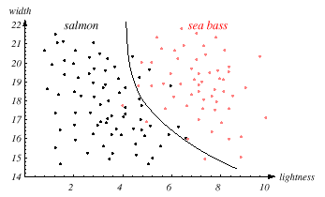

Slide 19
Pattern Recognition Systems
Sensing
  Use of a transducer (camera or microphone)
  PR system depends of the bandwidth, the resolution sensitivity distortion of the transducer
Segmentation and grouping
  Patterns should be well separated and should not overlap

Slide 20
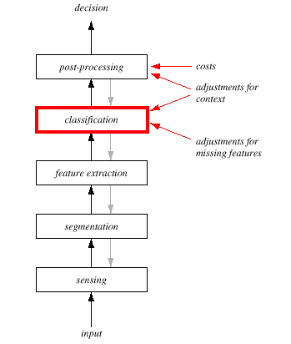

Slide 21
Feature extraction
  Discriminative features
  Invariant features with respect to translation, rotation and scale.
Classification
  Use a feature vector provided by a feature extractor to assign the object to a category
Post Processing
  Exploit context input dependent information other than from the target pattern itself to improve performance

Slide 22
The Design Cycle
Data collection
Feature Choice
Model Choice
Training
Evaluation
Computational Complexity

Slide 23
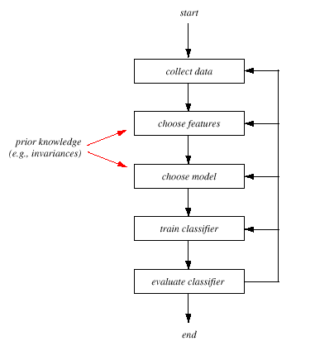

Slide 24
Data Collection
  How do we know when we have collected an adequately large and representative set of examples for training and testing the system?

Slide 25
Feature Choice
  Depends on the characteristics of the problem domain. Simple to extract, invariant to irrelevant transformation insensitive to noise.

Slide 26
Model Choice
  Unsatisfied with the performance of our fish classifier and want to jump to another class of model

Slide 27
Training
  Use data to determine the classifier. Many different procedures for training classifiers and choosing models

Slide 28
Evaluation
  Measure the error rate (or performance and switch from one set of features to another one

Slide 29
Computational Complexity
  What is the trade-off between computational ease and performance?
  (How an algorithm scales as a function of the number of features, patterns or categories?)

Slide 30
Learning and Adaptation
Supervised learning
  A teacher provides a category label or cost for each pattern in the training set
Unsupervised learning
  The system forms clusters or “natural groupings” of the input patterns

Slide 31
Conclusion
Reader seems to be overwhelmed by the number, complexity and magnitude of the sub-problems of Pattern Recognition
Many of these sub-problems can indeed be solved
Many fascinating unsolved problems still remain

